Slide 1
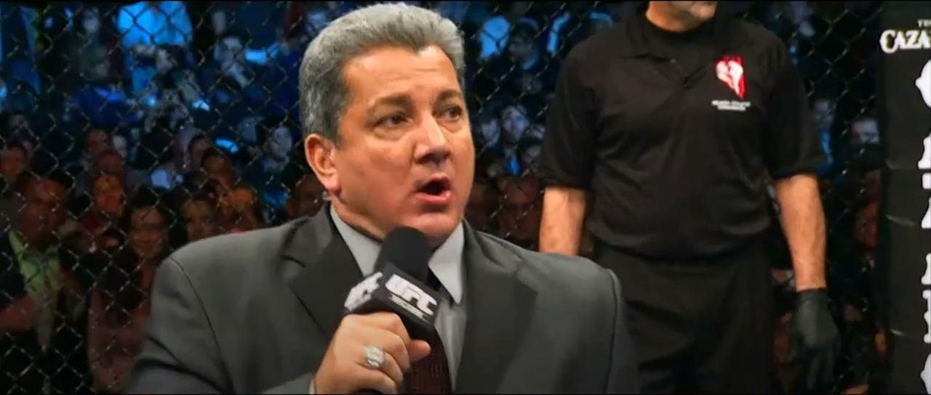
Notes:
Cesar Greeting - 0:15 seconds (“Its Time!”... … “In the Data Science World we all know Dimas is the reigning champ but what about hypothetically in the Octagon? ”)
Priti/Cesar Intro - (breaks down MMA lingo, introduces audience to the world of MMA & stuns with viz) - 3:30 minutes
Cesar hands-off to Mattie - 0:15 seconds
Mattie DB - 3:30 minutes
Cesar hands-off to Andrew - 0:15 seconds
Andrew - ML - 3:30 minutes
Cesar hands-off to self - 0:15 seconds
Cesar/Priti - Results including Interactive Visualization - 2:00 minutes
Closing Slides - Fun Facts, Credits and Sources - 1:30 minutes

Slide 2
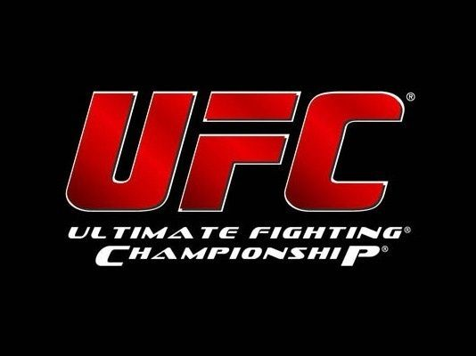
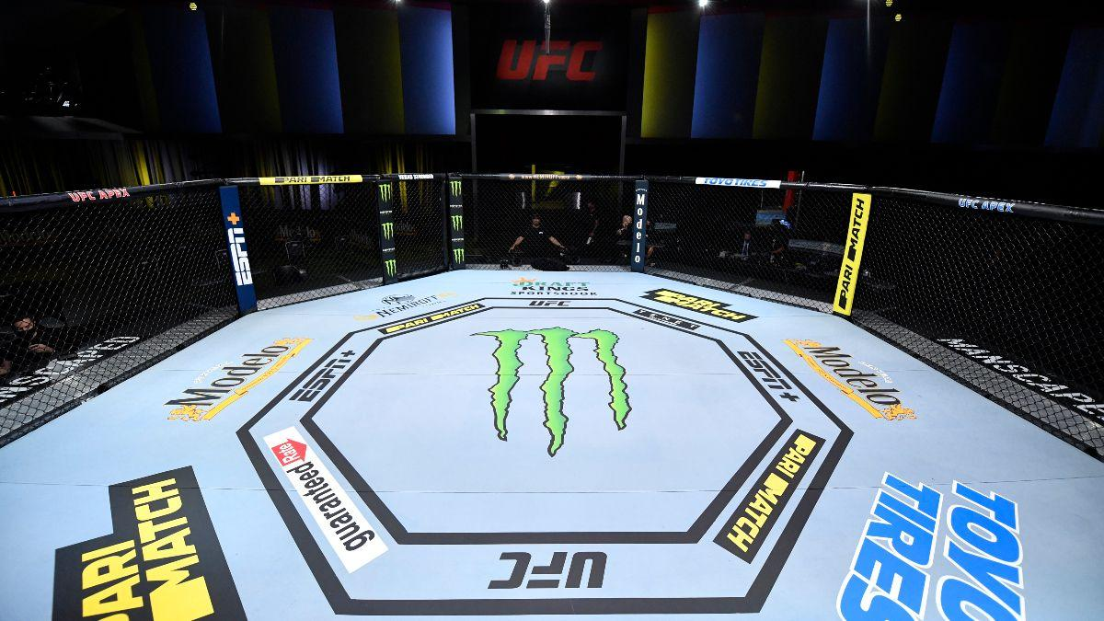
Ladies and Gentlemen
IT’S TIMEEEEE!!!
Notes:
Ladies and Gentlemen.. IT’S TIMEEEEEE!!

Slide 3
Enter photoshopped UFC flyer
Notes:
Introducing.. CHAMPION FIGHTING!! In the red corner is a bootcamp instructor, a business intelligence professional, coming in at ()()(), Dimas Torres Llorca!! Challenging him in the blue corner is an admired teaching assistant and a machine learning pro, Tejas Nanaware!!
Similar line for the “opening fight” - Gonzalo Garcia vs Josh Farmer
Place your bets!

Slide 4
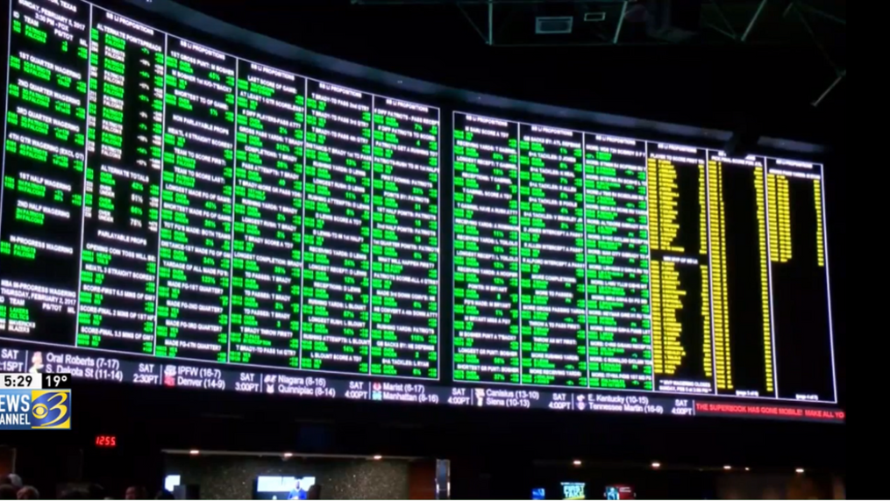
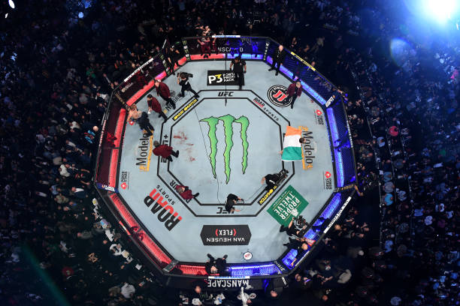
$155 billion
Notes:
Sport betting is a $155 billion industry.
Fighting ranks among the top in the industry, and the Ultimate Fighting Championship (UFC) is currently taking steps to push it even further.
What would you need to know before placing your bet..?

Slide 5
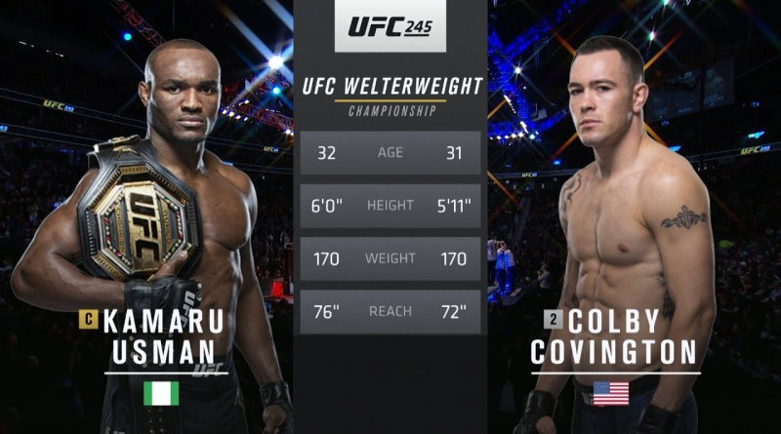

Notes:
Mixed Martial Arts (MMA) fighter statistics involve everything from skill centric values such as wins and significant strikes to physiological measurements such as height and reach. There are over 100 features that can be analyzed before any given fight..
So where's the edge?
With the power of data, our goal is to see if machine learning can be used to best understand which features are most relevant in order to find trends and predict the outcomes (win/draw/loss) of each fight.

Slide 6

UFC Match Outcome Predictor
A quest to predict the unknown
Notes:
Cesar Greeting - 0:15 seconds (“In the Data Science World we all know Dimas is the reigning champ but what about hypothetically in the Octagon? As Bruce Buffer said its time to find out”)
Priti/Cesar Intro - (breaks down MMA lingo, introduces audience to the world of MMA & stuns with viz) - 3:30 minutes
Cesar hands-off to Mattie - 0:15 seconds
Mattie DB - 3:30 minutes
Cesar hands-off to Andrew - 0:15 seconds
Andrew - ML - 3:30 minutes
Cesar hands-off to self - 0:15 seconds
Cesar/Priti - Results including Interactive Visualization - 2:00 minutes
Closing Slides - Fun Facts, Credits and Sources - 1:30 minutes

Slide 7
Quest for W’s
The What, When & Where of Winning
Just like fighters strive to win, we strive to harness the power of data science to help us win by answering complex questions.
Our quest is to explore if there is a way to wrangle and distill data such that we are able to determine the future outcome of UFC fights based on previously fought bout data metrics.

Slide 8
What?
Why?
Where?
01
02
03
Topic:
Our Process:
Source:
Use data and fighter statistics to create an educated prediction on who will win the fight.
As fans, it would be interesting to best predict who will win a fight.
We acquired a dataset from UFC saved in Kaggle.com

Slide 9
What We Plan On Answering
1. What are the top 5 fighter metrics that contribute to winning a UFC match?
2. Which of the fighter metrics carry more weight than the others?
3. How much do biometric physical factors, i.e. age, height, weight, affect the outcome of the match?
4. Does having a higher rank predict the outcome?
5. Do the number of win streaks necessarily predict a higher chance of winning?

Slide 10
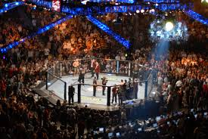

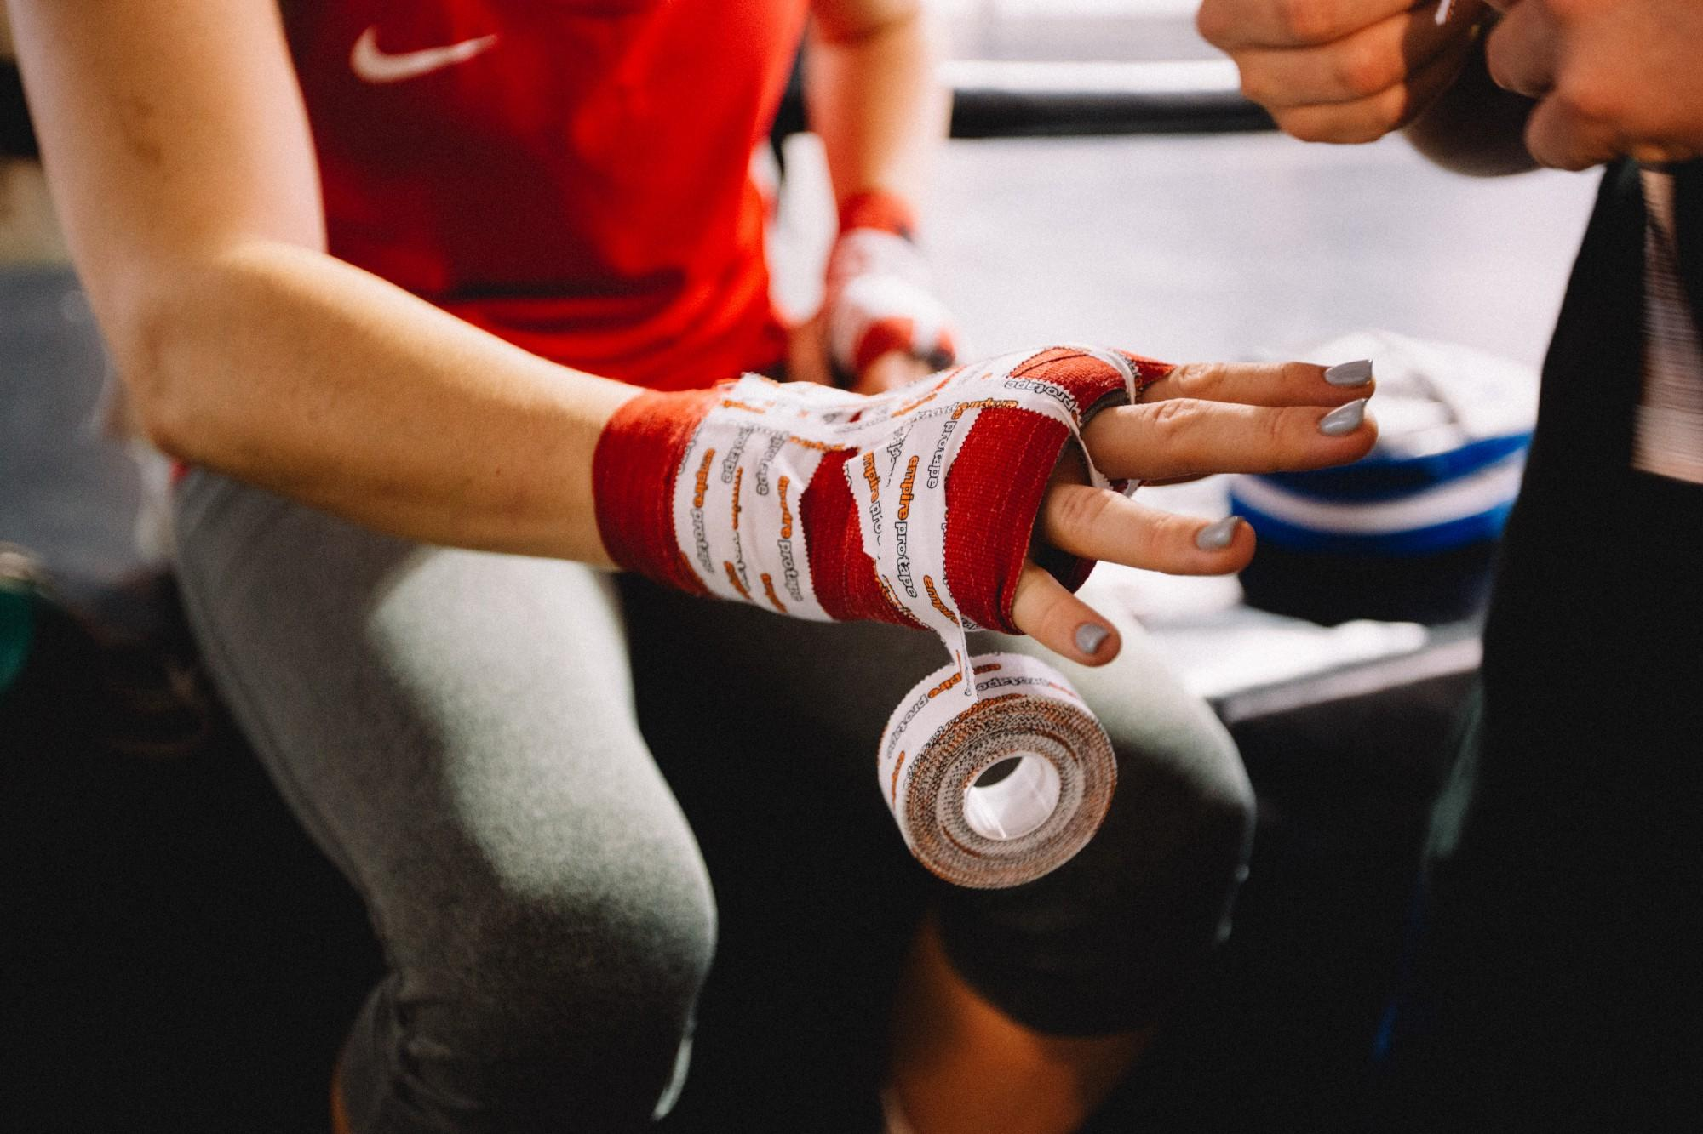
Dataset and Features
4,566
1,286
137
UFC Fights
Fighters
Variables
dating from March 2010
to Feb 2021
and their previous
bout metrics
correlating to Red and Blue fighters
Notes:
The Ultimate Fighting Championship (UFC) is a mixed martial arts (MMA) promotion that has held over 500 events since its beginning in 1993. The purpose of the early UFC competitions was to identify the most effective martial art in a contest with minimal rules and no weight classes between competitors of different fighting disciplines like boxing, kickboxing, brazilian jiu jitsu, wrestling, taekwondo, and judo. The UFC started as an idea to promote a family's martial arts school.

Slide 11
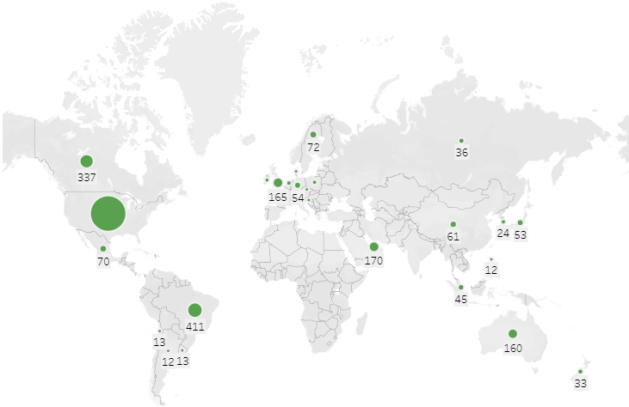
Notes:
In the early days, UFC fights were held only in states that didn't have athletic commissions to avoid regulation. The UFC has now expanded to 25 countries; the number of bouts held outside the US has increased from 61 in 2010 to 236 in 2019.
More than 59% of fights were held in the US while Brazil held the most fights outside the US.

Slide 12
Data Exploration phase
Blue
Red
Differences in the average accuracy of takedowns taking place between fighters were calculated by using the following function: “Blue corner score minus (-) Red corner score” where a negative score actually favors the Red corner fighter.
Exploring historical data of past matchups in the UFC for past multiple years, it was found that the great majority of the time, the fighter in the red corner has a slightly greater chance as the victor in a match-up

Slide 13
Database Slide?

Slide 14



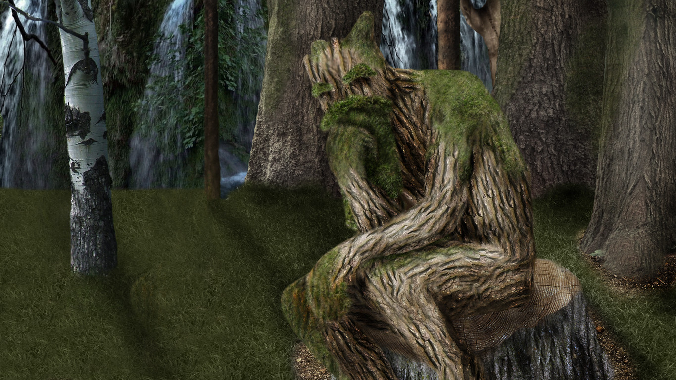
Analysis Phase
We compared the following 4 models to see which model best fit our data, research requirements and structure.
K-Nearest Neighbors
Random Forest Model
Decision Trees
Logistic Regression Models
Supervised learning algorithm
Simple, supervised machine learning algorithm
Builds regression or classification models in the form of a tree structure
Basic statistical model that uses a logistic function to model a binary dependent variable
Notes:
K-Nearest Neighbors: K-Nearest Neighbour is one of the simplest Machine Learning algorithms based on Supervised Learning technique. K-NN algorithm assumes the similarity between the new case/data and available cases and put the new case into the category that is most similar to the available categories.
Random Forest Model: Random forest is a supervised learning algorithm. The "forest" it builds, is an ensemble of decision trees, usually trained with the “bagging” method. The general idea of the bagging method is that a combination of learning models increases the overall result.
Logistic Regression Models: Logistic regression models the probabilities for classification problems with two possible outcomes. It's an extension of the linear regression model for classification problems.
Decision Trees: A class of very powerful Machine Learning model cable of achieving high accuracy in many tasks while being highly interpretable. What makes decision trees special in the realm of ML models is really their clarity of information representation.

Slide 15
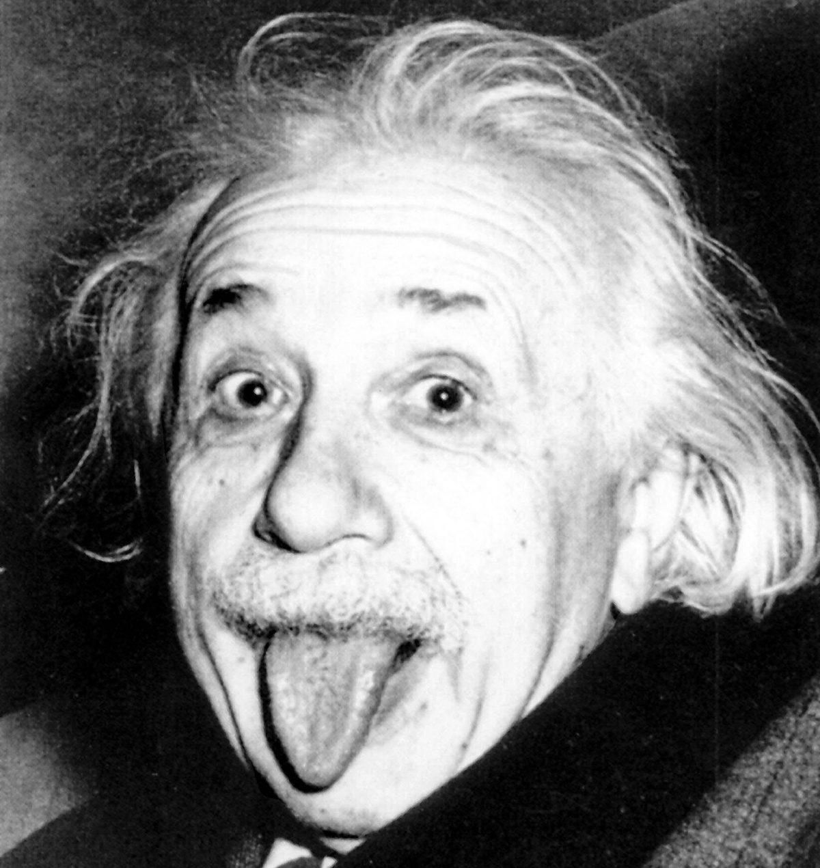
Albert Einstein
“Everything should be made as simple as possible, but not simpler.”
Notes:
Fundamentally, a baseline is a model that is both simple to set up and has a reasonable chance of providing decent results.

Slide 16
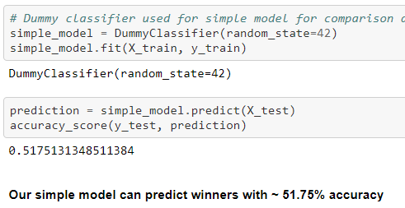
Can’t have a good model without a good base
Logistic Regression Model
For our base model we chose the Logistic Regression model
Our simple model can predict winners with the below accuracy percentage:
Notes:
“Just like you can’t be a good fighter without a solid base or foundation from which to work from, you can’t have a good machine learning model without first creating a baseline model.
When trying to classify structured data or natural language, logistic regressions will usually give you quick, solid results.
Our simple model without removing null values can predict winners with ~ 51.75% accuracy
Since nobody is truly satisfied with a 50/50 odds we had some tweaking to do to improve accuracy of baseline LR model even before comparing new models.

Slide 17
The Chosen Two
Neural Network Models
Random Forest Model
Great for images, audio or text.
Facilitates agile simple model implementation to gather a baseline
Prerequisites include filling missing values, converting categorical data into numerical and scale features into the same range or at the very least similar.
Seamless feature engineering transition to improve accuracy
Great for tabular data
Automates missing values present in the data.
Requires less preprocessing and the training process is simpler.
Reduces overfitting by aggregating several decision trees which helps improve accuracy and reduces error due to bias.

Slide 18
Machine Learning Analysis I
Preliminary data preprocessing, feature engineering, feature selection and decision-making process
Using the resources-master.csv file, we first wanted to create a baseline classification model Simple_Model.ipynb in order to establish a benchmark of how well a winner could be predicted without data preprocessing and feature engineering. Using the Dummy Classifier, which allows us to run the model with null values, the model predicted winners with 51.75% accuracy.
We have a very robust dataset with 137 columns of data. In order to achieve better model performance we must:
Feature Engineer - Limit input features by combining similar variables in order to increase correlation
Eliminate 'noisy' data
Find null values and fill them
Encode categorical variables

Slide 19
Machine Learning Analysis II
How data was split into training
Improved Accuracy > baseline accuracy via feature engineering
Ran correlation function.
Consolidated duplicate data by creating ‘difference’ variable
Dropped similar characteristics (i.e. date, location & weight class etc)
Dropped all ranking columns except one pertinent to eliminate null values
NaN columns filled with true zero value
Testing sets and model choice—limitations and benefits
Compared NN vs RF
Both resulted in over 75% accuracy (NN-76% vs RF 78%).
Best results attained with standard 25% test split.
Both models did not overfit which is ideal.
Notes:
How data was split into training
We then set out to create a model that would perform better than our baseline model, by first preprocessing the data and implementing feature engineering- data_preprocessing.ipynb. In this dataset we were dealing with 137 variables many of which contained a significant amount of null values. In order to ensure key variables were not eliminated, we first encoded the winning column and ran a correlation function in pandas to see which variables most correlated to winners. After that, we recognized that the majority of our variables were duplicates in a sense—statistics for the Red Corner fighter, and statistics for the Blue Corner fighter. To increase correlation and concentrate the data, we subtracted all Red Corner statistics from Blue Corner statistics (Blue-Red) and created 'difference' variables. Then we dropped all variables that were common to both fighters in that fight; such as date, location, weight class, ect. Looking at the data further we recognized there was a large chunk of variables associated to rankings in a given weight class that contained a significant amount of null values. After further analysis only one of these rankings columns was pertinent and all the others were dropped. Then columns with strings were encoded, and false NaN columns were filled with their true value of 0.
Testing sets and model choice—limitations and benefits
For our improved model we decided to compare the results between a Random Forest classifier and a Deep Neural Networkufc_RF_vs_NN.ipynb, because we were looking to classify winners with a very large dataset. We tinkered with different train/test splits but results were best with a standard 25% test split. The RF Classifier resulted in 78% accuracy while the Deep NN resulted in 76% accuracy. It does not seem that either model was overfit, and they were able to predict winners of the fights with over 75% accuracy.

Slide 20
Description of Tools to Create Final Dashboard
Description of Interactive Elements
For our presentation, we utilized the following tools to create visualizations:
Google Slides
Tableau Public
Python
Seaborn
MatPlotLib.PyPlot
Pandas
Table with heat map to showcase intensity of fighter statistics against one another
Chart with label brushing to allow for automatic appearance of an identifying label when the cursor hovers over a particular plot element
Table with filters to easily select fighters statistics for side by side comparison
Notes:
Do yall think we should delete this?

Slide 21
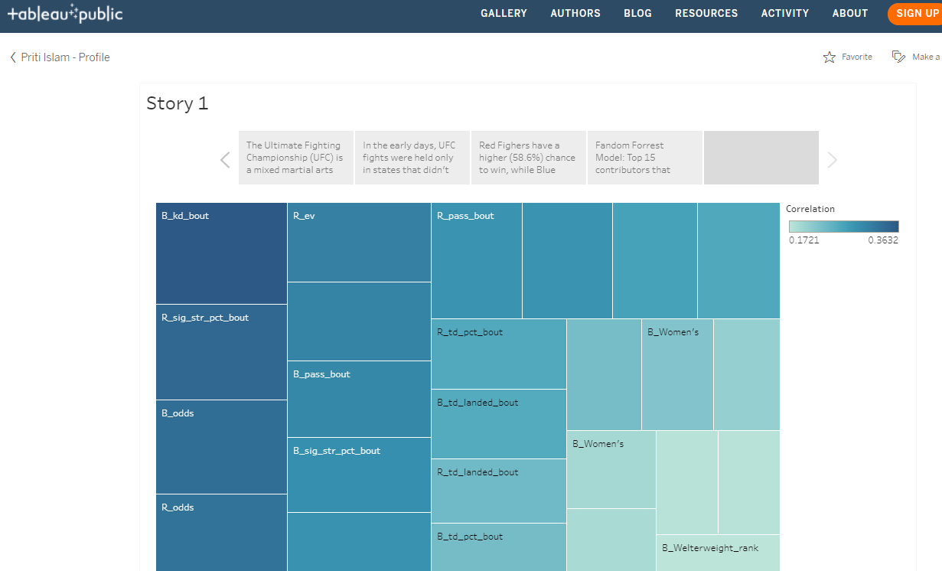
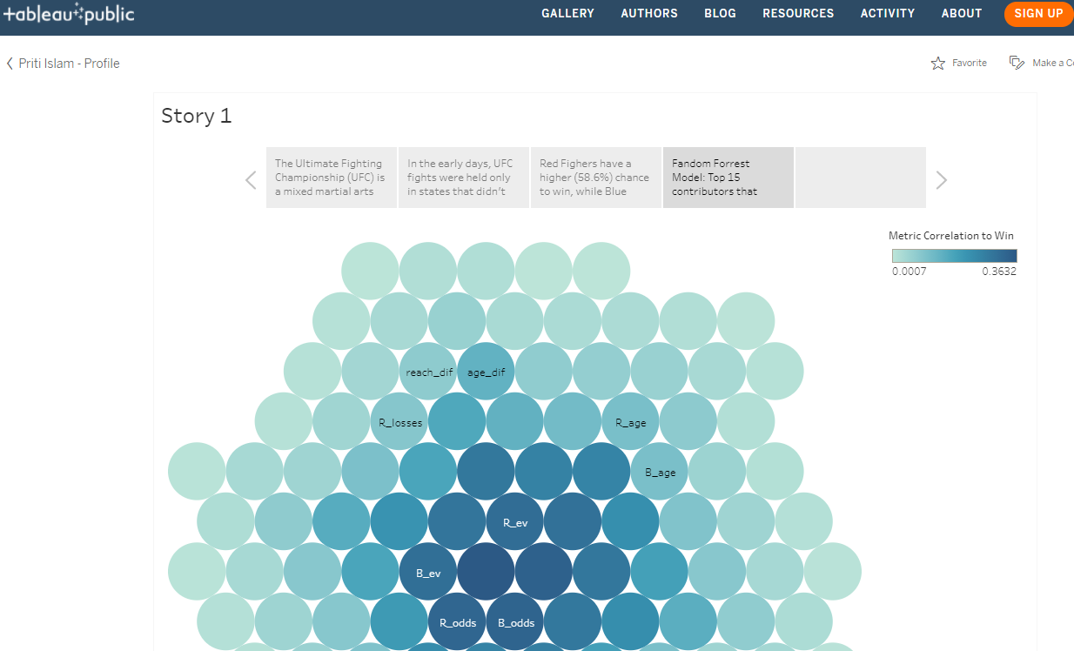
Dashboard Preview
URL Link

Slide 22
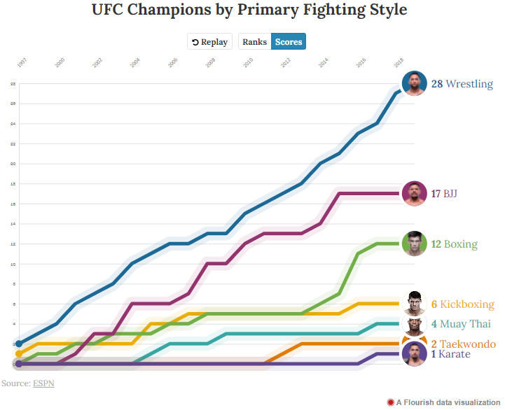
Fun Fact
Most UFC champions have one base in common:
Strong Wrestling Background
Notes:
Since UFC started in 1993 there have been 190 crowned champions these past 28 years
28 UFC champions, roughly 15% of all champs, have come from the sport of wrestling, making it the most prevalent base for UFC gold
Moral of the story: “No matter how hard a kick boxer trains his wrestling when he's in his twenties and ready to start MMA, he will likely never be able to stop the takedowns of a guy who's been wrestling since he was a kid.”

Slide 23
Source
Poll: Best Base?
Folkstyle Wrestling Produces UFC Champions.
ESPN MMA Base Viz

Slide 24
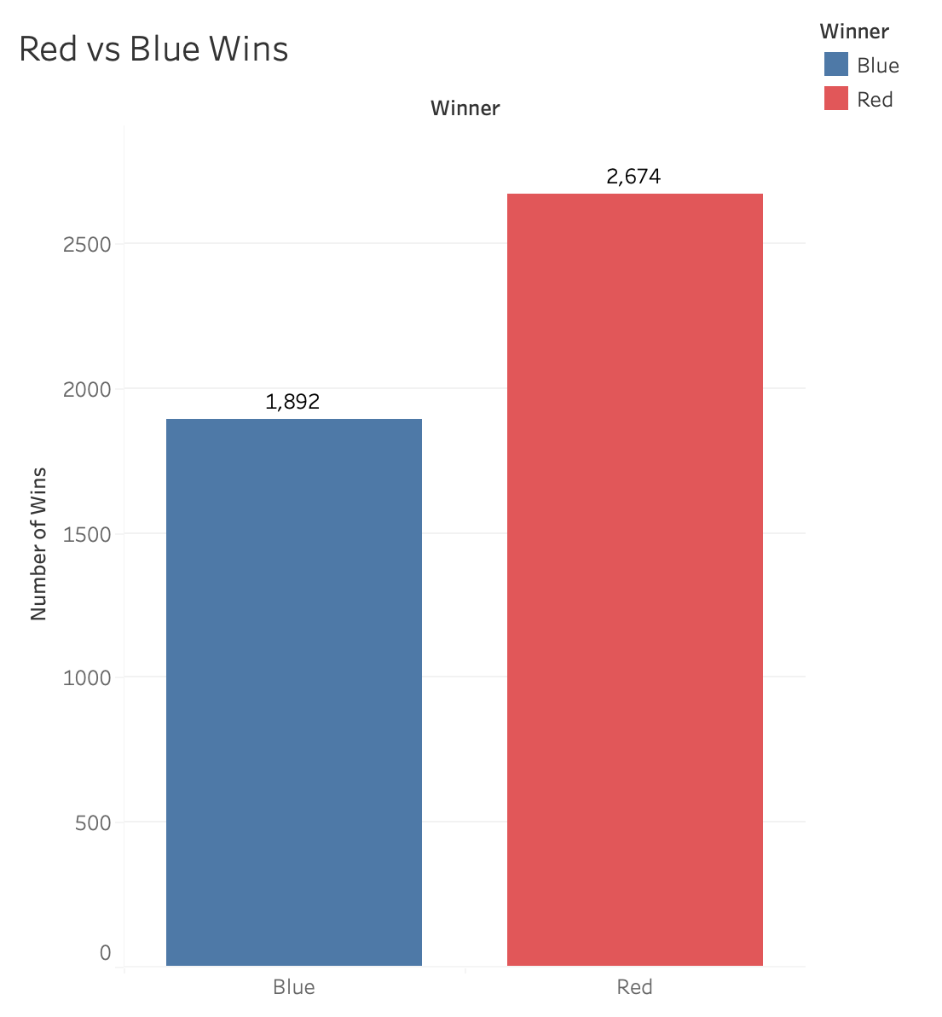
Results
Fighting on the red corner offers a 17% higher chance of winning alone.
Notes:
Red Fighters have a higher (58.6%) chance to win, while Blue Fighters have a lower (41.4%) chance to win. Thus, fighting on the red corner offers a 17% higher chance of winning alone.

Slide 25
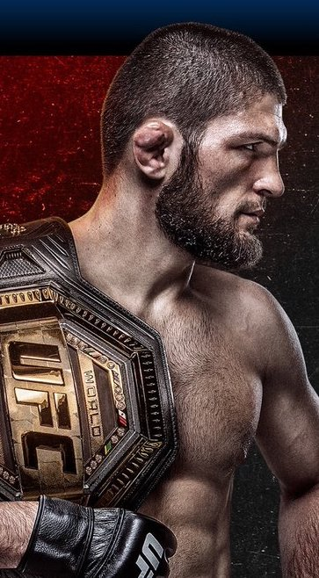
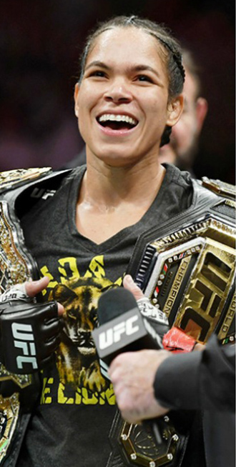

WHO WILL YOU
BET ON NEXT?

